Slide 1
ChatGPT enhanced Chatbots
Project Structure

Slide 2
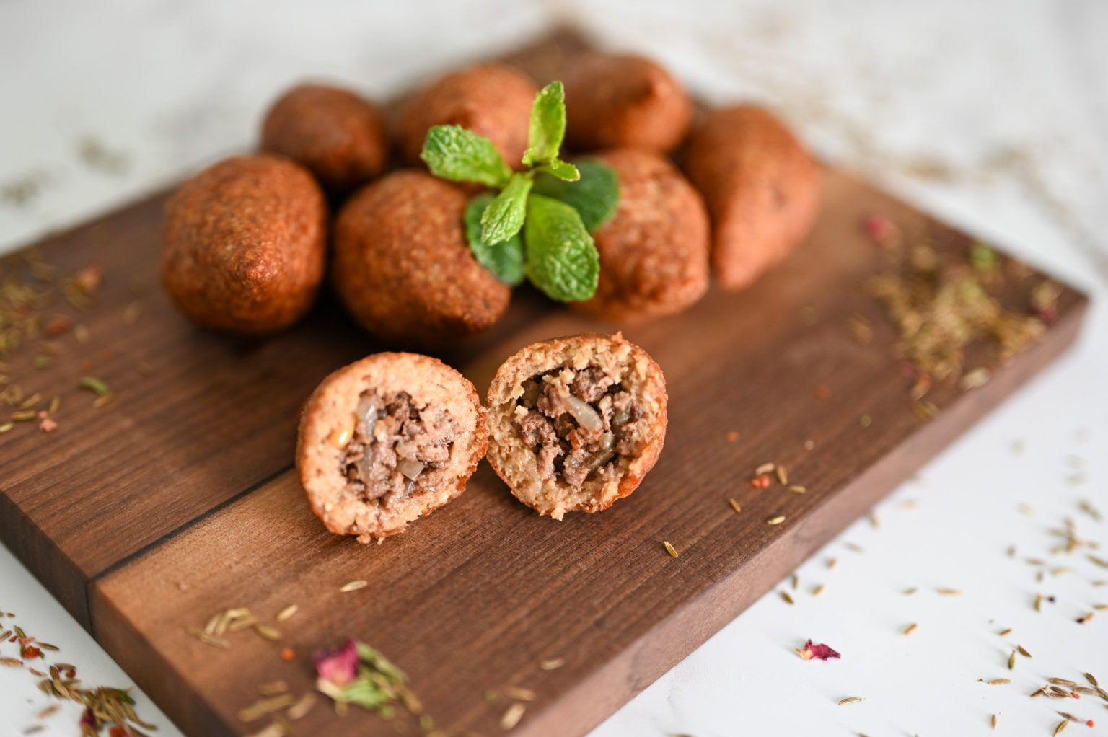
Website
Topic: Recipes
Allows for users to upload documents (PDF, docx, xlsx, txt, …)
Documents may contain:
  Meal plans
  Shopping lists
  Digital receipts

Slide 3



Front End
HTML
CSS
JavaScript

Slide 4



Back End
Python with Flask
AWS

Slide 5
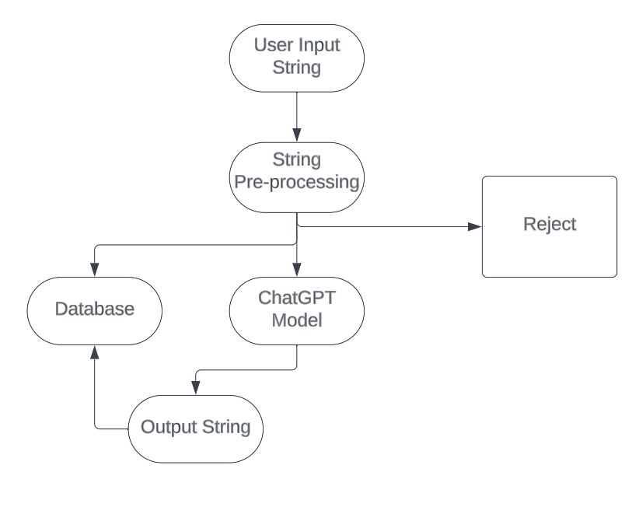
Workflow

Slide 6
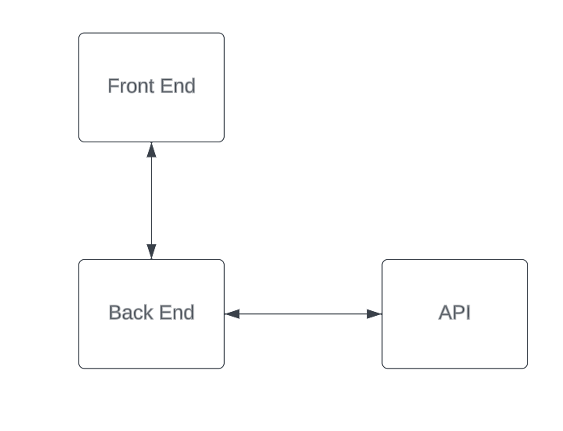
API
Uses ChatGPT to process input text
Flask in Python
SQL database with MariaDB
AWS Server (separate to the website)

